Slide 1

IOSA Presentation
“The most popular tweet” (according to the chosen hashtag)
Jean Mouvilliat Thierry Zhang Claire Touron Toscan Vertanessian Geoffroy Rouaix
<numéro>

Slide 2
Plan
The Story I. The request (the bash) II. Data treatments III. Results

Slide 3
The Story
Here, the idea of our project:
“During PSG matches, a TV channel would like to share with his viewers the tweet that makes the " buzz " around a player or an event (# Zlatan for example).”
So we create a script wich stocks the last 1500 tweets about an hashtag, analysis and returns the most popular and most retweeted tweets.

Slide 4
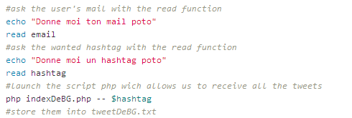
The Request
Push the Hashtag you want to analyse + your email

Slide 5
Data Treatment
Get the Hashtag, the eMail
Split the information with the sed function and store it in different files (favorites, retweeted,name,content)
Analyse the files to get the most retweeted and favorite tweets

Slide 6
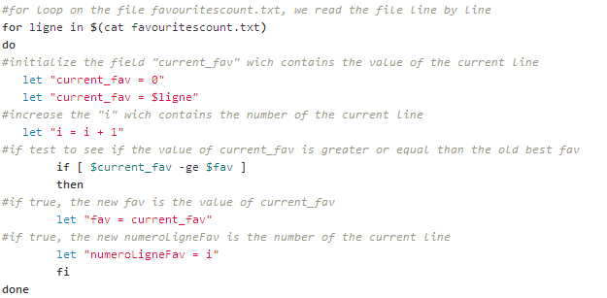
Data Treatment

Slide 7
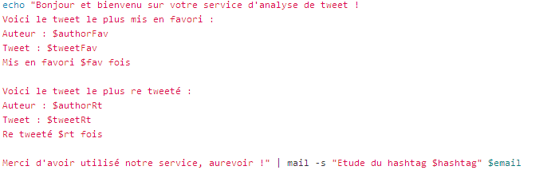
Results
Send an email with the results

Slide 8
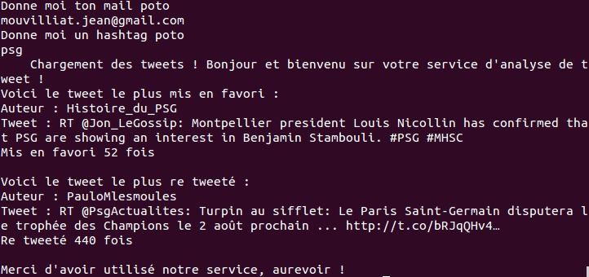
Result from the terminal

